Slide 1

FY 2025 All Funds Budget
Finance and Operations Committee
March 15, 2024

Slide 2
All Funds Budget:
Goals and Objectives
Purpose: Part of a UNC system-wide effort to improve transparency and strategic allocation of resources by budgeting all revenue streams that have historically not been part of an annual budget process.
The Board of Governors requires all UNC System campuses to develop an “All Funds Budget” in an effort to:
  Better align resources with strategic priorities (See Appendix)
  Promote stewardship and financial sustainability
  Enhance data and reporting capabilities across funding sources in order to better allocate resources
  Better understand the impact of discrete decisions on the broader financial picture
  Improve transparency and campus engagement
  Strengthen the fiduciary responsibility of the Board of Trustees

Slide 3
All Funds Budget:
Goals and Objectives
By requiring a more robust review of all institutional resources, this process provides a structural foundation for the execution of the System’s strategic plan and the strategic plan of each constituent institution.

Slide 4
All Funds Budget:
Fund Types
Fund Type | Includes | Source
General Fund | State Appropriations, Tuition, Graduate Tuition Increments, Educational Receipts, Summer Receipts | FY 2024 base budget overlaid with legislative increases for employee salaries & benefits, enrollment growth, and projected new general funds
Auxiliary & Other Trust Funds | Auxiliaries, Student Fees and Unrestricted Trust Funds | FY 2025 budget projections provided by Auxiliary & Fee-supported units
Overhead Receipts | Federal Facilities and Administrative Cost (F&A Receipts) | Centrally projected based upon historical actuals
Restricted Trust Funds | Restricted Trust Funds (e.g. scholarships, professorships) and Contracts & Grants | Centrally projected based upon historical actuals

Slide 5
All Funds Budget:
Structural Elements
Specified Units
College of Arts and Sciences | Facilities
College of Business | Human Resources
College of Education (incl. lab school) | Information Technology
College of Health Sciences | Public Safety
College of Fine and Applied Arts | Advancement
School of Music | Dining
Academic Affairs (incl. Enrollment Management) | Housing
Student Affairs | Parking & Transportation
Financial Aid | Athletics
Library | Student Health
Sponsored Research | Other Auxiliaries
University Administration | New River Light and Power
Finance & Operations
Template requires reporting across common academic and administrative organizational structures
Increases the University’s ability to use financial data to make strategic decisions
Provides valuable information on how the institution uses resources to plan and meet its strategic goals

Slide 6
FY25 All Funds Budget
Summary

Slide 7
1) General Fund net transfers ($5.5M) represent Auxiliary Overhead support for services rendered to the auxiliary units and Campus Security Fee support for Police and Title IX positions.
2) Auxiliary & Other Trust net transfers are largely comprised of transfers out for capital improvement projects, capitalized equipment leases and auxiliary overhead assessments.
Notes:
Auxiliary net transfers includes $8.34M of Dining transfers out for capital improvements ($1M Central Dining roof repair, $6.34M All-Access remodel, $1M Retail Outlet remodel) as well as transfers out associated with the annual Auxiliary Overhead assessment.

Slide 8
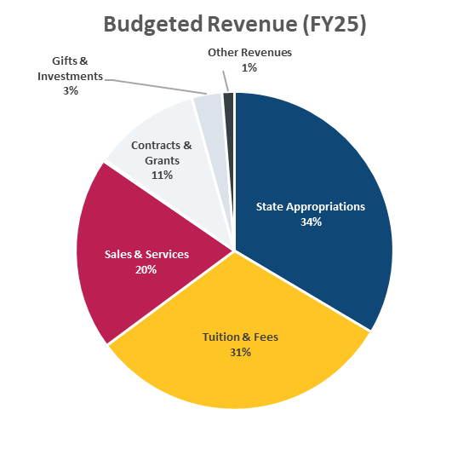

Slide 9
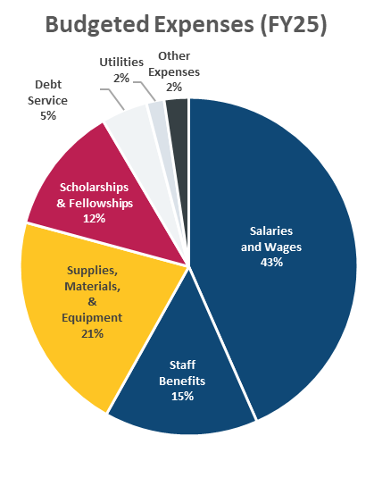

Slide 10
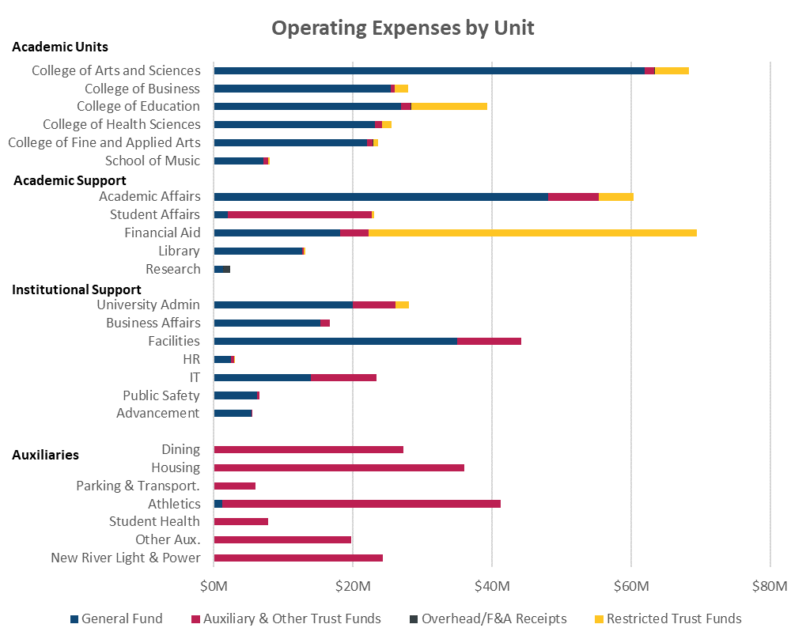

Slide 11
Appendix: Institutional and UNC System Strategic Priorities

Slide 12
All Funds Budget:
Institutional Strategic Priorities
App State’s Strategic Plan (2022-2027):
“Empowering Human Potential through the Appalachian Experience”
  Priority 1: Providing Exceptional Educational Experiences
  Priority 2: Advancing Research, Innovation and Creativity
  Priority 3: Advancing Local, Regional and Global Engagement
  Priority 4: Advancing Diversity, Equity and Inclusion
  Priority 5: Investing in Faculty and Staff Excellence
  Priority 6: Strengthen Resilience and Sustainability

Slide 13
All Funds Budget:
UNC System-Wide Strategic Goals
UNC System Strategic Plan (2022-2027): “Higher Expectations”
  Category 1: Access
  Category 2: Student Success
  Category 3: Affordability and Efficiency
  Category 4: Economic Impact and Community Engagement
  Category 5: Excellent and Diverse Institutions
Other UNC Strategic Priorities:
  Student Affordability

